Slide 1
Chapter 3 Data Structures and Applications
Note: Before you proceed further, make sure to learn about pointers and structs.
Fikadu Wayesa

Slide 2
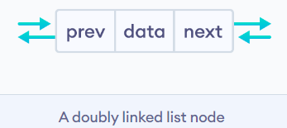
2. Doubly Linked List
Doubly linked list is a type of data structure that is made up of nodes that are created using self referential structures.
Each of these nodes contain three parts, namely the data and the reference to the next list node and the reference to the previous list node.
Only the reference to the first list node is required to access the whole linked list.
This is known as the head.
The last node in the list points to nothing so it stores NULL in that part.
Also the doubly linked list can be traversed in both directions as each node points to its previous and next node.
A doubly linked list is a type of linked list in which each node consists of 3 components:
*prev - address of the previous node
data - data item
*next - address of next node
https://www.programiz.com/dsa/doubly-linked-list

Slide 3
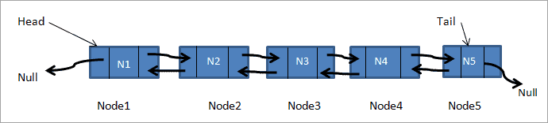
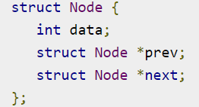
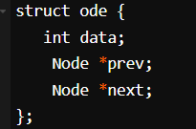
Node Representation
As in the singly linked list, the doubly linked list also has a head and a tail.
The previous pointer of the head is set to NULL as this is the first node.
The next pointer of the tail node is set to NULL as this is the last node.
The first node of the linked list is the head and the last node is the tail.
If head is NULL then the list is empty.
Declaration-In C-style declaration, a node of the doubly linked list is represented as follows:
C++

Slide 4
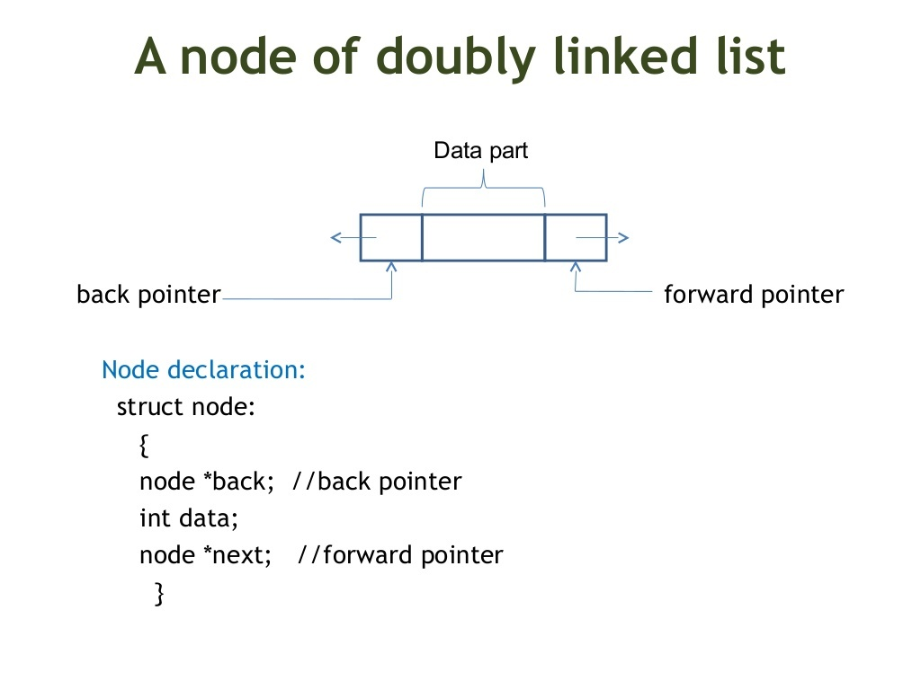
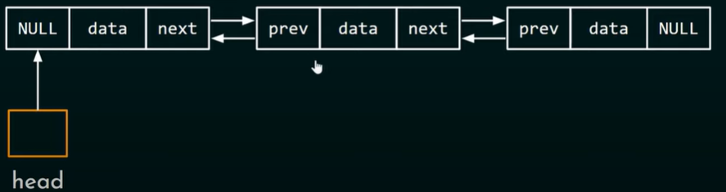

Slide 5
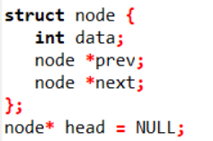





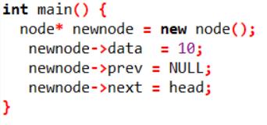

Doubly Linked List (Inserting a Node in an Empty List)

Slide 6
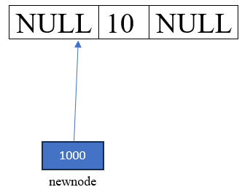
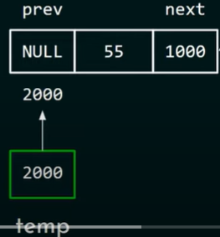
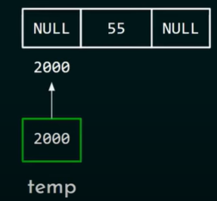
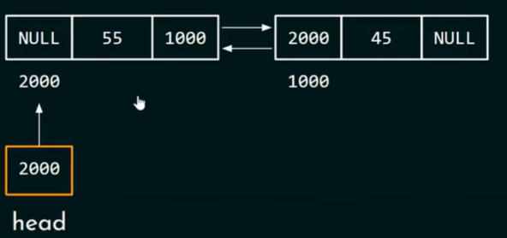
Double Linked List Node (Insertion at beginning)
The first thing we have to do is to update next pointer of the temp node
Initial List
temp->next=head
Next we have to update the previous pointer of the first node the address of the current node
Our target is to add this
node Infront of this node
Resulting List
head->prev=temp
Then we have to update head pointer
head=temp

Slide 7
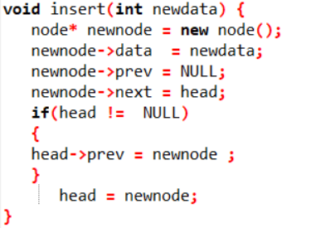
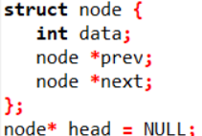
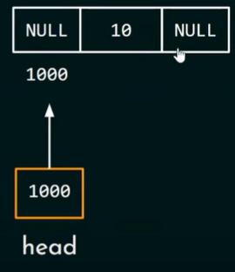
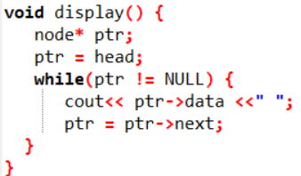
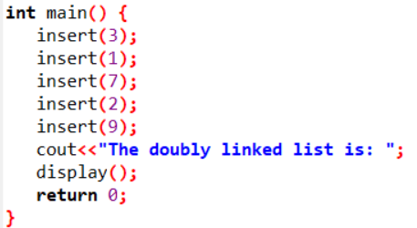
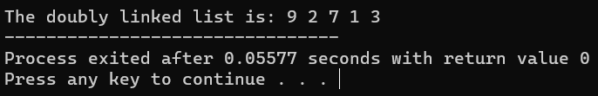
Double Linked List Node (Insertion at beginning)
2. Creating a function that creates a node
1. Declaring a node
3. Display the list
4. Calling Function in main
5. Output

Slide 8
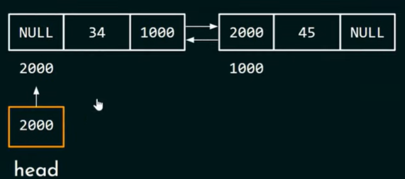
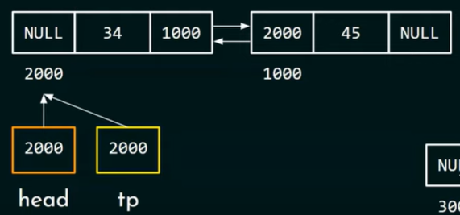
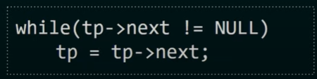

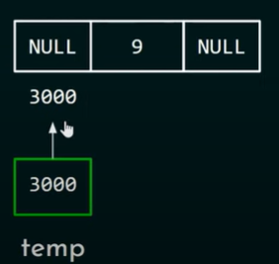
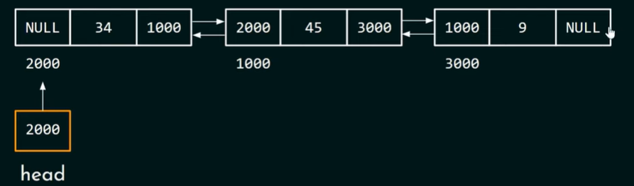
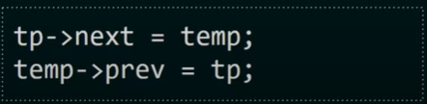
Doubly Linked List (Insertion at the End)
Step 1: Traversal
Our target is to add this node at the end of the list
Step 2: While temp->next==NULL, attach the new node to the end

Slide 9
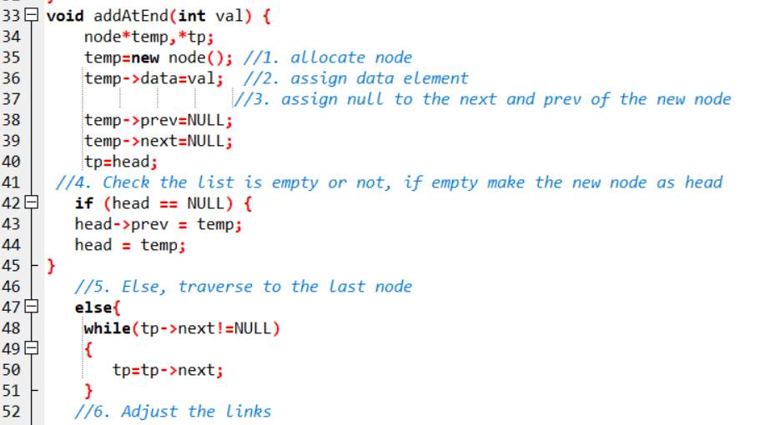
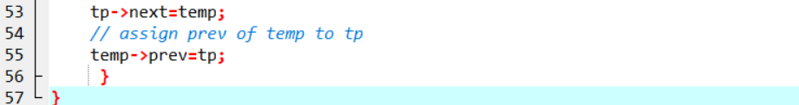
C++ Implementation of adding last node

Slide 10
Doubly Linked List (Insertion between the Nodes)
Doubly Linked List (Deleting the Intermediate Node)
C++ - Delete odd nodes of the Doubly Linked List
C++ - Delete even nodes of the Doubly Linked List
C++ - Count nodes in the Doubly Linked List
C++ - Delete a node at the given position in the Doubly Linked List

Slide 11
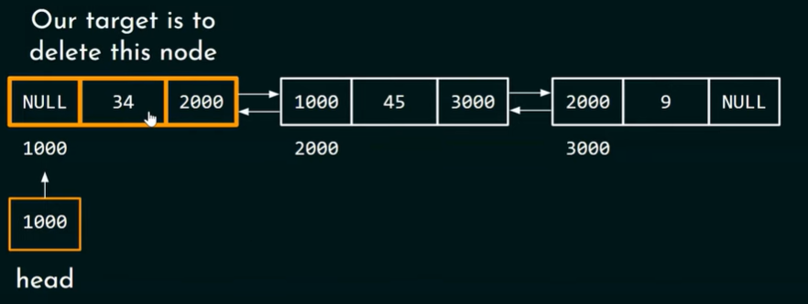
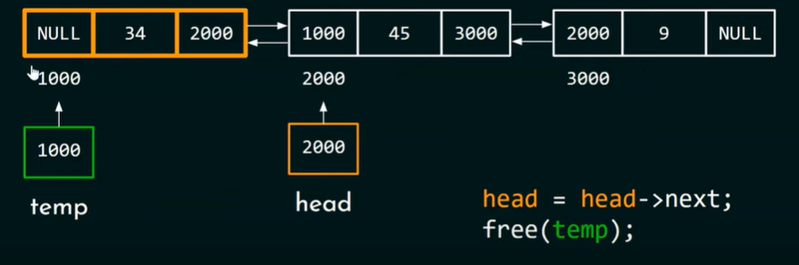
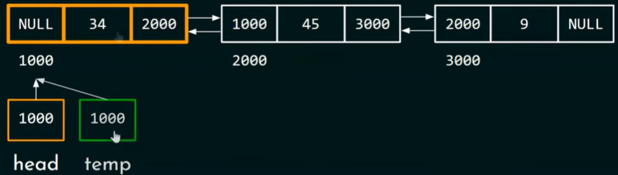
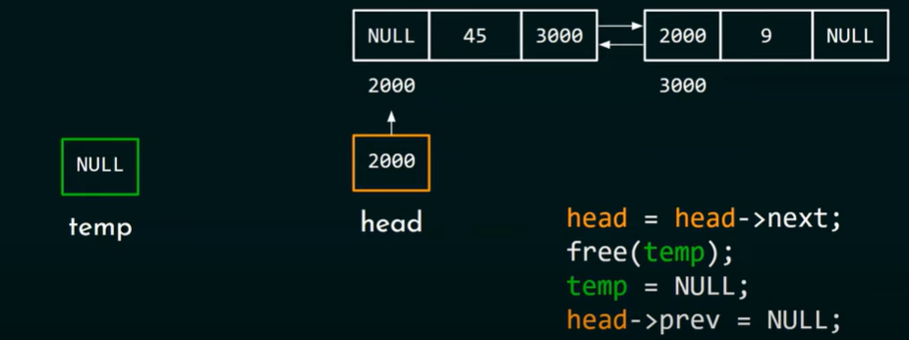
Doubly Linked List (Deleting the First Node)-Method 1

Slide 12
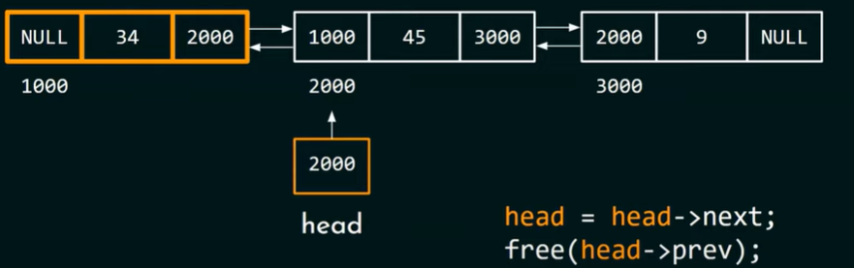
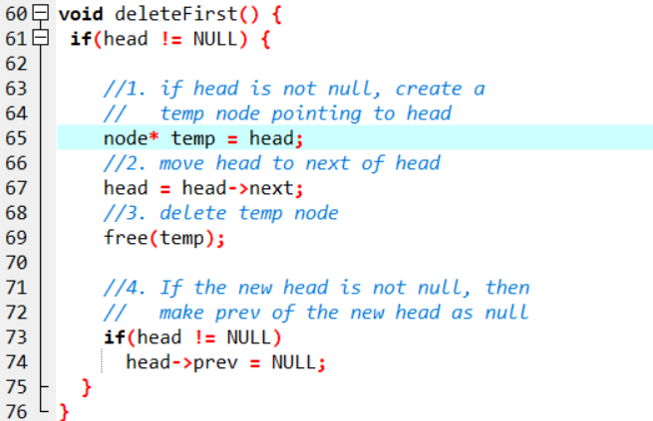
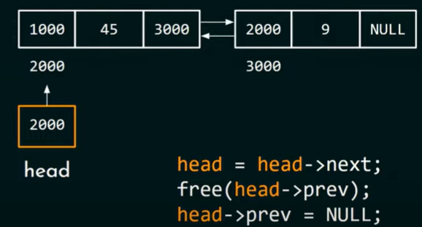
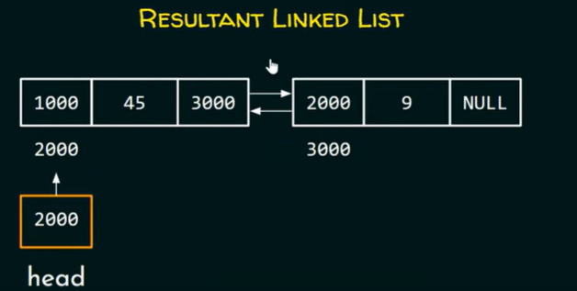
Doubly Linked List (Deleting the First Node)-Method 2

Slide 13
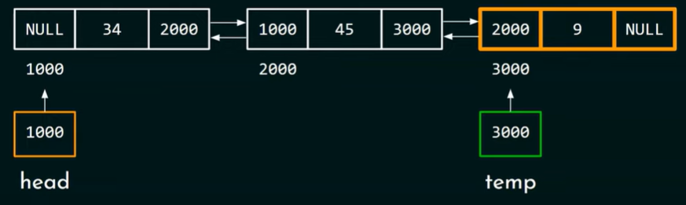
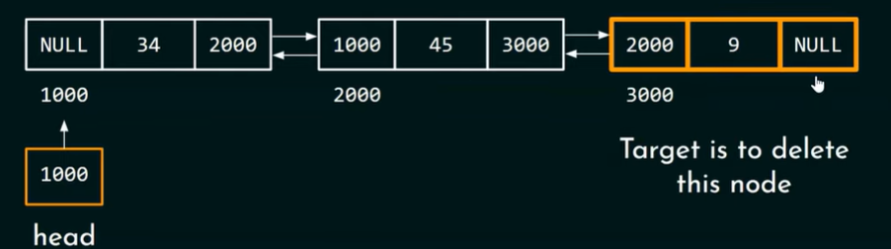
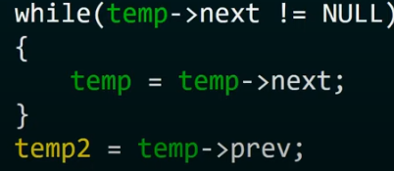
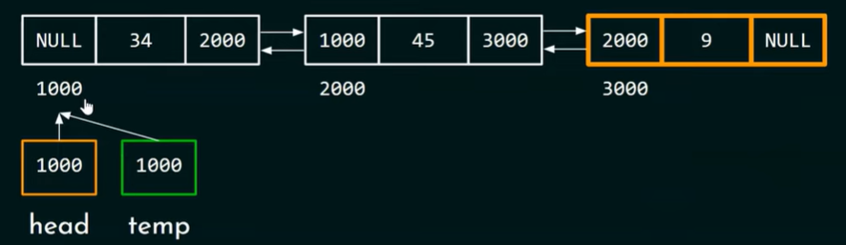
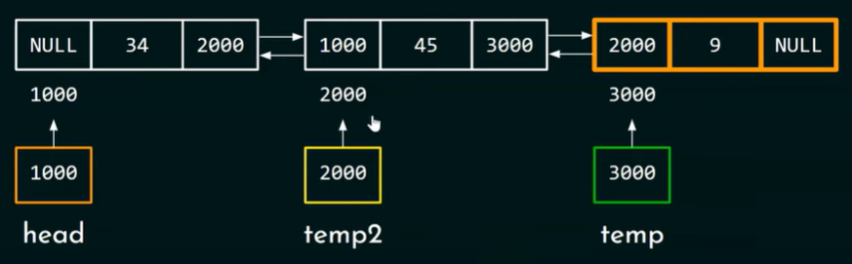
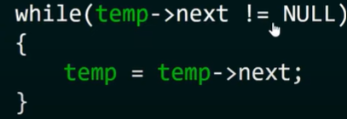

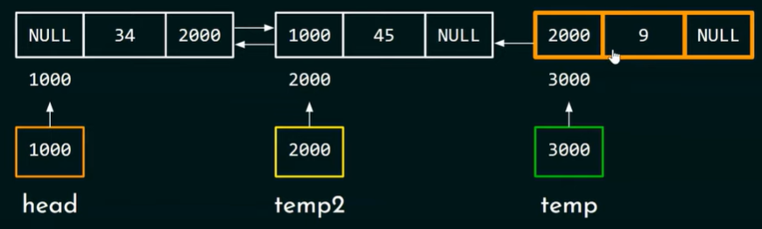
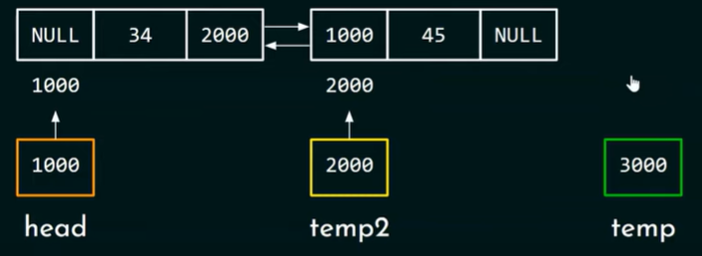


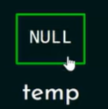
Last Deletion

Slide 14
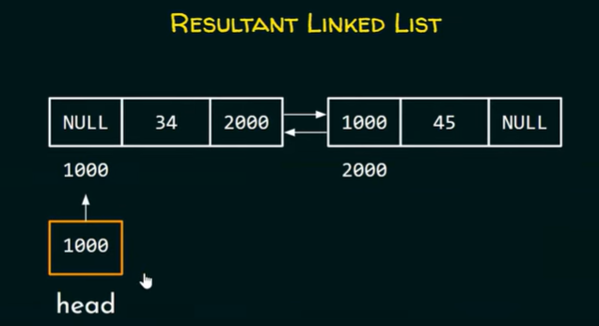
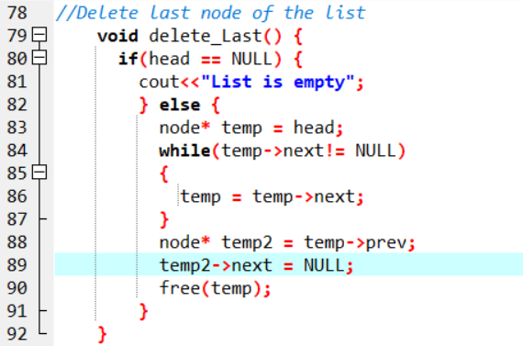
C++ Implementation

Slide 15
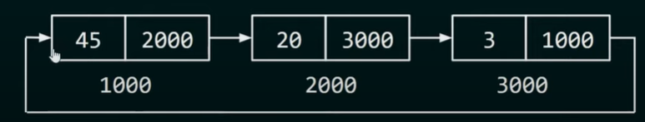
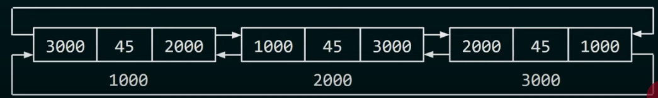
3. Circular Linked List
There are two types of circular Linked List
Circular Singly Linked List
Similar to the singly linked list except that the last node of the circular singly linked list points to the first node.
Circular doubly Linked List
Similar to the doubly linked list except that the last node of the circular doubly linked list points to the first node and the first node of the circular doubly linked list points to the last node.

Slide 16
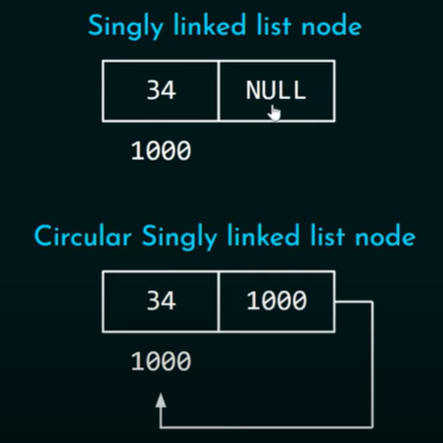
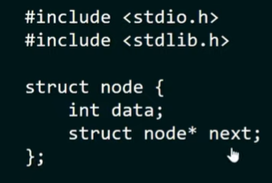
Creating- Circular Singly List

Slide 17
Applications of linked list
Implementation of stacks and queues
Implementation of graphs: Adjacency list representation of graphs is the most popular which uses a linked list to store adjacent vertices.
Dynamic memory allocation: We use a linked list of free blocks.
Maintaining a directory of names
Performing arithmetic operations on long integers
Manipulation of polynomials by storing constants in the node of the linked list
Representing sparse matrices

Slide 18
Applications of linked list in the real world
Image viewer – Previous and next images are linked and can be accessed by the next and previous buttons.
Previous and next page in a web browser – We can access the previous and next URL searched in a web browser by pressing the back and next buttons since they are linked as a linked list.
Music Player – Songs in the music player are linked to the previous and next songs. So you can play songs either from starting or ending of the list.
GPS navigation systems- Linked lists can be used to store and manage a list of locations and routes, allowing users to easily navigate to their desired destination.
Robotics- Linked lists can be used to implement control systems for robots, allowing them to navigate and interact with their environment.
Task Scheduling- Operating systems use linked lists to manage task scheduling, where each process waiting to be executed is represented as a node in the list.

Slide 19
Image Processing- Linked lists can be used to represent images, where each pixel is represented as a node in the list.
File Systems- File systems use linked lists to represent the hierarchical structure of directories, where each directory or file is represented as a node in the list.
Symbol Table- Compilers use linked lists to build a symbol table, which is a data structure that stores information about identifiers used in a program.
Undo/Redo Functionality- Many software applications implement undo/redo functionality using linked lists, where each action that can be undone is represented as a node in a doubly linked list.
Speech Recognition- Speech recognition software uses linked lists to represent the possible phonetic pronunciations of a word, where each possible pronunciation is represented as a node in the list.
Polynomial Representation- Polynomials can be represented using linked lists, where each term in the polynomial is represented as a node in the list.
Simulation of Physical Systems- Linked lists can be used to simulate physical systems, where each element in the list represents a discrete point in time and the state of the system at that time.

Slide 20
Application of Doubly Linked Lists:
Redo and undo functionality.
Use of the Back and forward button in a browser.
The most recently used section is represented by the Doubly Linked list.
Other Data structures like Stack, Hash Table, and Binary Tree can also be applied by Doubly Linked List.
Used to implement game objects and their interactions in a game engine.
Used in networking.
Used in Graph algorithms.
Operating systems use doubly linked lists to manage the process scheduling. Each process waiting to be executed is represented as a node in the doubly linked list, and the operating system can easily traverse the list in both directions to manage the process queue.

Slide 21
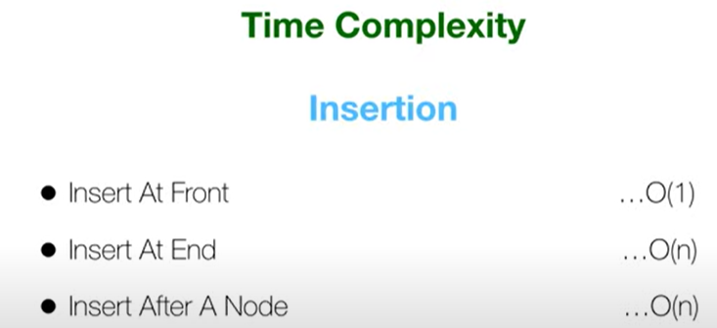



Complexity Analysis

Slide 22


Slide 23


Slide 24



